Slide 1

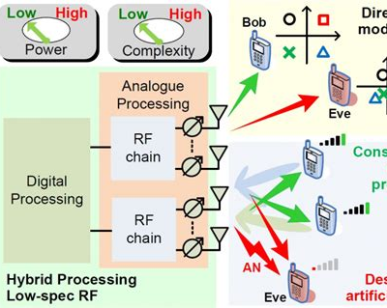
Physical Layer Security in Digital Communications
GROUP-5 Presentation

Slide 2

Content
1. Introduction to Physical Layer Security
2. Key Techniques in Physical Layer Security
3. Applications of Physical Layer Security
4. Challenges and Future Directions
5. Case Studies and Real-World Implications

Slide 3

Introduction to Physical Layer Security
Section 1

Slide 4




The Concept of Physical Layer Security
Defining Physical Layer Security
Physical Layer Security (PLS) is a paradigm shift in securing communication systems by leveraging the inherent characteristics of the physical communication channel to prevent eavesdropping and interception.
Historical Context
The evolution of PLS can be traced back to the early days of secure communication, with its roots in the principles of information theory and cryptography, evolving to meet the demands of modern digital communication systems.
Importance in Digital Communications
In today's digital age, PLS has become increasingly critical as it offers a robust security layer that complements traditional encryption methods, ensuring an additional barrier against potential cyber threats.
01
02
03

Slide 5


Principles of Physical Layer Security
Information-Theoretic Security
PLS is grounded in information theory, where security is achieved by ensuring that the information leakage to an eavesdropper is theoretically negligible.
Channel Characteristics
The uniqueness of the communication channel, such as noise and fading, is exploited in PLS to create a secure communication environment that is difficult for an eavesdropper to replicate or decode.
Advantages Over Traditional Security
PLS provides security that is independent of computational hardness assumptions, making it a strong alternative or complement to traditional cryptographic methods that may be vulnerable to quantum computing attacks.

Slide 6
Components of Physical Layer Security
Key Generation
The process of generating encryption keys from the physical layer attributes, such as channel state information, which are inherently random and unique to each communication session.
Signal Design
The design of communication signals that are inherently secure, such as using waveforms that are difficult to intercept or decode without the proper channel knowledge.
Channel Coding
The use of coding techniques that introduce redundancy and error correction in a way that only legitimate receivers can correctly decode the transmitted message.
01
02
03

Slide 7
Key Techniques in Physical Layer Security
Section 2

Slide 8



Secure Key Generation
Channel-Based Key Generation
Utilizing the unique and time-varying characteristics of the wireless channel to generate secret keys that are shared between the communicating parties.
Randomness Extraction
Techniques for extracting randomness from the physical layer to create high-entropy keys that are unpredictable and secure against eavesdropping.
Key Reconciliation
Methods to ensure that the keys generated at both ends of the communication are identical, despite the presence of noise and channel variations.

Slide 9
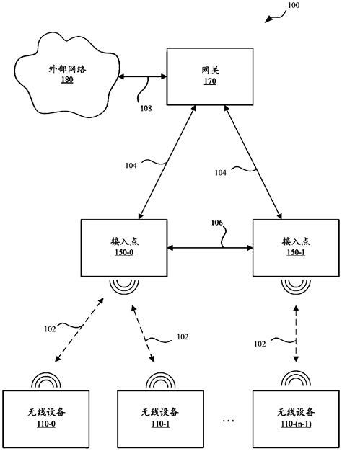
Signal Secrecy Methods
Friendly Jamming
Introducing controlled interference in the communication channel to confuse eavesdroppers while allowing legitimate users to communicate securely.
Directional Beamforming
Using antenna arrays to focus the transmission energy towards the intended receiver, minimizing the risk of interception by unintended parties.
Artificial Noise
Adding noise to the transmitted signal in a way that degrades the eavesdropper's reception without affecting the intended receiver's ability to decode the message.

Slide 10
Channel Coding for Security
Wiretap Channel Coding
Designing codes that ensure a high error rate at the eavesdropper's receiver while allowing the intended receiver to decode the message with low error probability.
Low-Density Parity-Check (LDPC) Codes
Implementing LDPC codes that provide both error correction and security by exploiting the asymmetry in channel conditions between the legitimate receiver and the eavesdropper.
Polar Codes
Leveraging polar codes to achieve both channel capacity and secrecy capacity, providing a secure and efficient coding strategy for PLS.
01
02
03

Slide 11
Applications of Physical Layer Security
Section 3

Slide 12
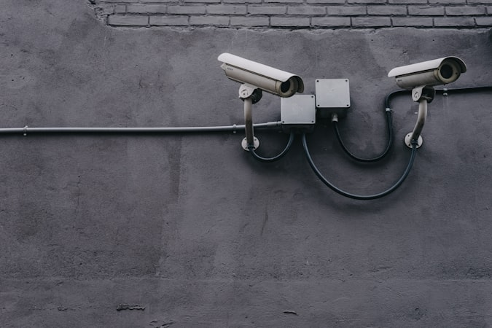


Wireless Communication Networks
Mobile Networks
Implementing PLS in mobile networks to protect against eavesdropping and unauthorized access, enhancing the security of cellular communications.
Wi-Fi Security
Leveraging PLS techniques in Wi-Fi networks to secure wireless data transmission against interception and to complement existing security protocols like WPA3.
Internet of Things (IoT)
Applying PLS to IoT devices and networks to ensure secure data exchange in scenarios where traditional cryptographic methods may be impractical due to resource constraints.

Slide 13

Defense and Military Communications
Secure Tactical Communications
Utilizing PLS in military communication systems to ensure secure and reliable information exchange in hostile environments where the risk of interception is high.
Drone Communication Security
Applying PLS to secure the communication links between drones and control stations, protecting against eavesdropping and hijacking attempts.
Satellite Communication
Enhancing the security of satellite communication systems through PLS, safeguarding against threats in the vast and exposed space environment.

Slide 14
Critical Infrastructure Protection
Smart Grid Security
Implementing PLS in smart grid communication networks to protect against cyber-physical attacks and to ensure the integrity of energy distribution systems.
Transportation Systems
Applying PLS to secure communication in intelligent transportation systems, including vehicle-to-vehicle (V2V) and vehicle-to-infrastructure (V2I) communications.
Healthcare Data Transmission
Ensuring the confidentiality and integrity of sensitive healthcare data transmitted over wireless networks by incorporating PLS techniques.
01
02
03

Slide 15

Challenges and Future Directions
Section 4

Slide 16



Current Limitations of Physical Layer Security
Scalability Issues
Addressing the challenges of scaling PLS techniques for widespread adoption across various communication systems and environments.
Complexity and Cost
Balancing the complexity and cost of implementing PLS with the security benefits, making it accessible for a broader range of applications.
Integration with Existing Systems
Overcoming the hurdles of integrating PLS into existing communication infrastructures without disrupting current operations and services.

Slide 17



Research and Development in PLS
Advancements in Coding Techniques
Exploring new coding strategies that enhance the secrecy and reliability of PLS, pushing the boundaries of what is achievable in secure communications.
Quantum-Resistant Security
Investigating PLS methods that are resistant to quantum computing attacks, ensuring that communication security remains robust in the post-quantum era.
Machine Learning and PLS
Employing machine learning algorithms to optimize PLS techniques, adapting to dynamic communication environments and threat landscapes.

Slide 18
Standardization and Regulation
Section 5

Slide 19
Future of Physical Layer Security
Emerging Technologies
Examining the role of PLS in emerging technologies such as 5G, 6G, and beyond, anticipating the security needs of future communication networks.
PLS in a Connected World
Envisioning a future where PLS is an integral part of the global communication infrastructure, providing a secure foundation for the increasingly connected world.
Educational Initiatives
The importance of education and training in PLS, equipping the next generation of engineers and researchers with the knowledge and skills to innovate and maintain secure communication systems.
01
02
03

Slide 20
Thank You
GROUP-5

